Slide 1
Music Store Data Analysis
Sql Project

Slide 2

Introduction
1. The purpose of the music store data analysis is to gain insights and make informed decisions based on the available data.
2. It allows them to identify their best-selling items, optimize their inventory and pricing strategies, personalize their marketing campaigns based on customer preferences, and target specific regions or customer segments.

Slide 3
Insights

Slide 4
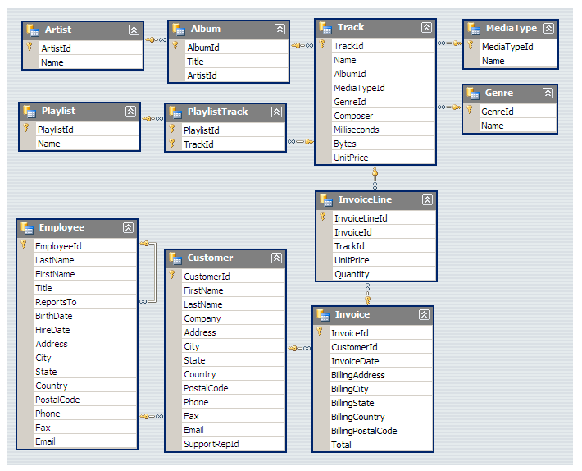
Schema

Slide 5
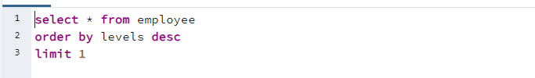
Question 1
Who is the senior most employee based on job title?
Answer
Madan Mohan

Slide 6
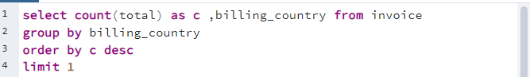
Question 2
Which countries have the most Invoices?
Answer
USA

Slide 7
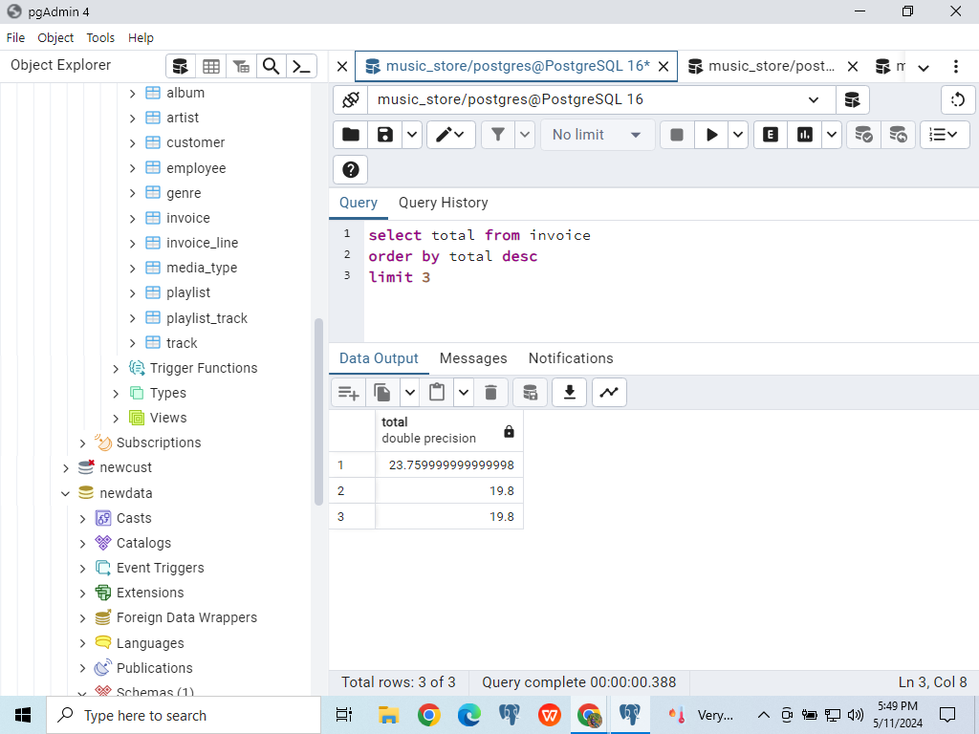
Question 3
What are top 3 values of total invoice?
Answer

Slide 8
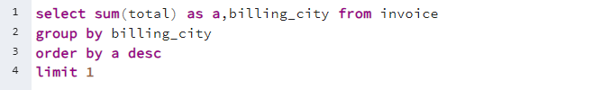
Question 4
Which city has the best customers? We would like to throw a promotional Music Festival in the city we made the most money. Write a query that returns one city thathas the highest sum of invoice totals. Return both the city name & sum of all invoice totals.
Answer
Prague

Slide 9
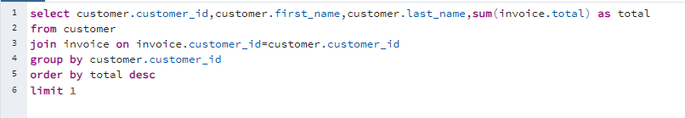
Question 5
Who is the best customer? The customer who has spent the most money will be declared the best customer. Write a query that returns the person who has spent the most money.
Answer
R Madhav

Slide 10
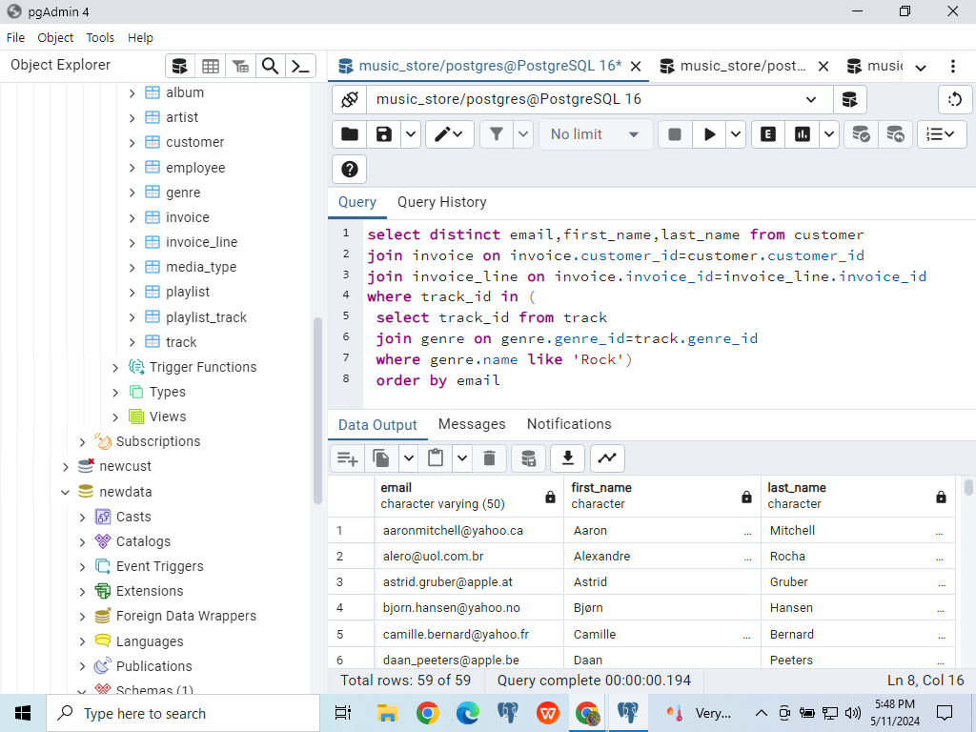
Question 6
Write query to return the email, first name, last name, & Genre of all Rock Music listeners. Return your list ordered alphabetically by email starting with A .
Answer

Slide 11
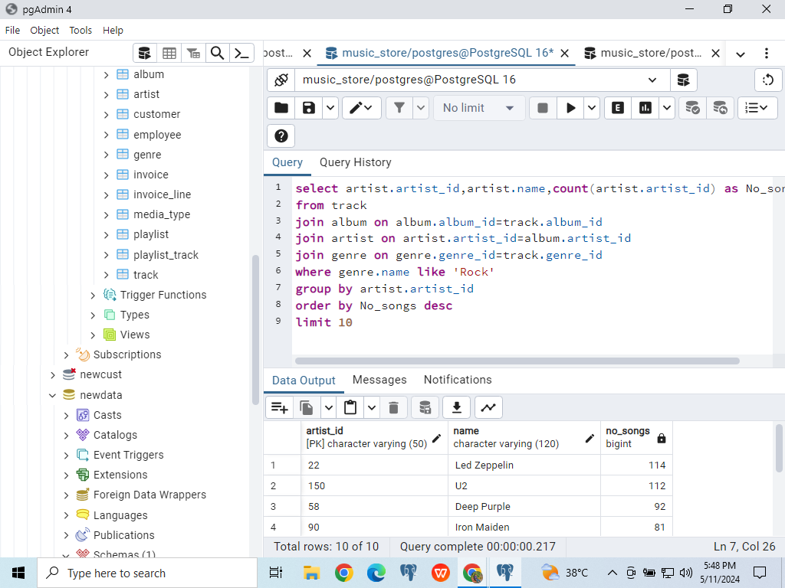
Question 7
Let's invite the artists who have written the most rock music in our dataset. Write a query that returns the Artist name and total track count of the top 10 rock bands
Answer

Slide 12
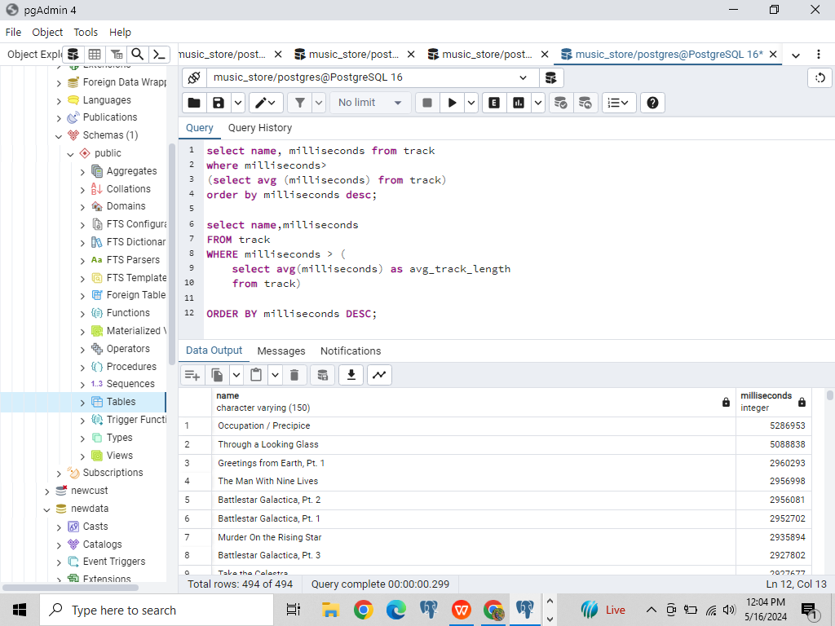
Question 8
Return all the track names that have a song length longer than the average song length. Return the Name and Milliseconds for each track. Order by the song length with the longest songs listed first .
Answer

Slide 13
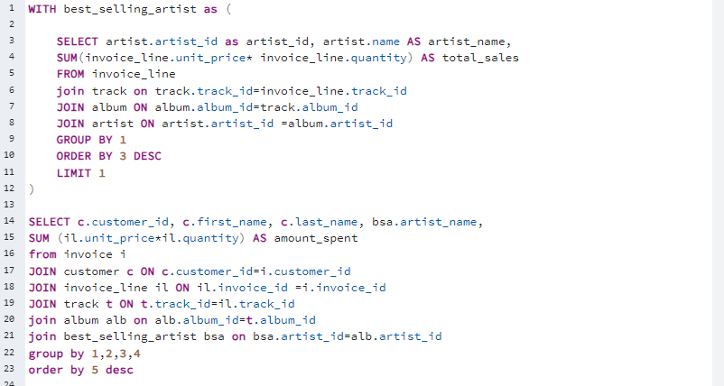
Question 9
Find how much amount spent by each customer on artists? Write a query to return customer name, artist name and total spent.

Slide 14
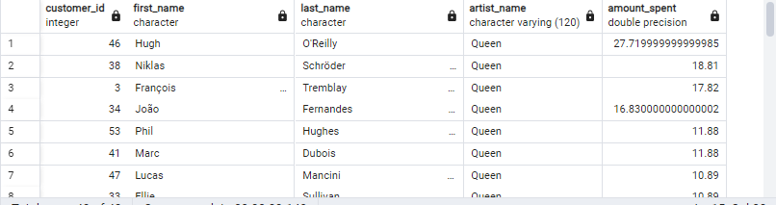
Answer

Slide 15
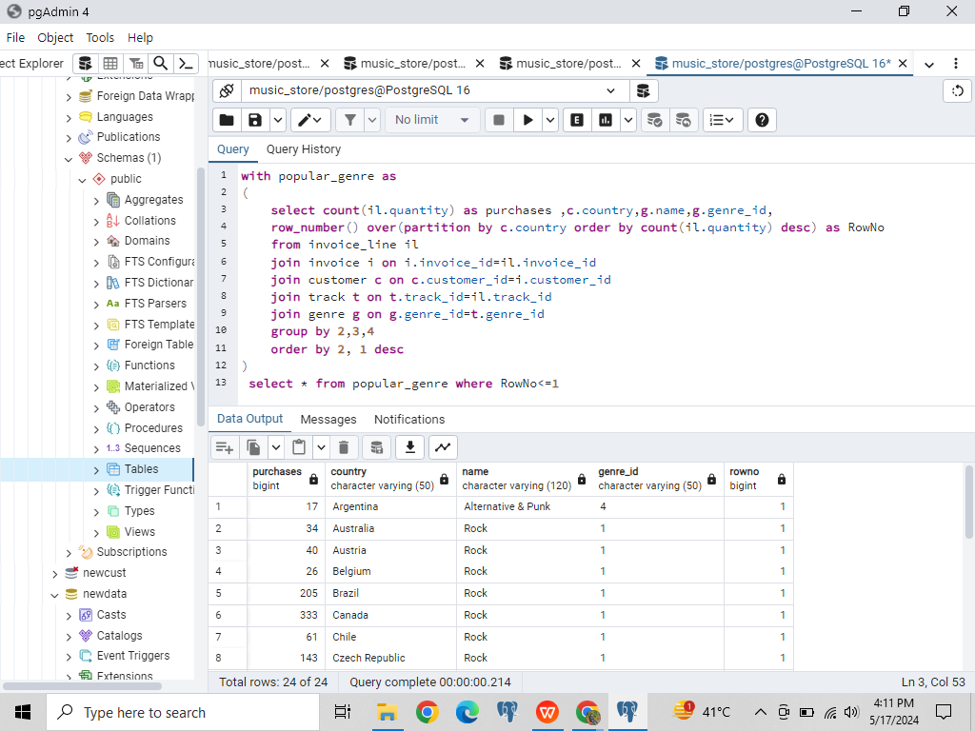
Question 10
We want to find out the most popular music Genre for each country. We determine the most popular genre as the genre with the highest amount of purchases. Write a query that returns each country along with the top Genre. For countries where the maximum number of purchases is shared return all Genres.

Slide 16
Answer

Slide 17
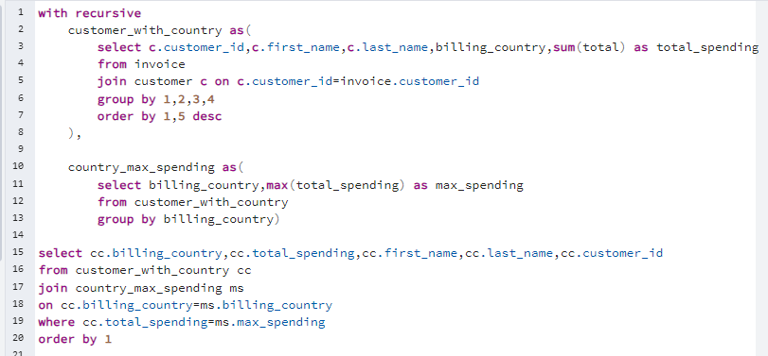
Question 11
Write a query that determines the customer that has spent the most on music for each country. Write a query that returns the country along with the top customer and how much they spent. For countries where the top amount spent is shared, provide all customers who spent this amount.

Slide 18
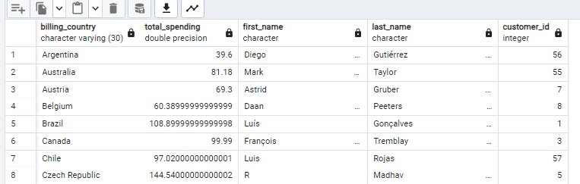
Answer

Slide 19
Thank You

